Slide 1
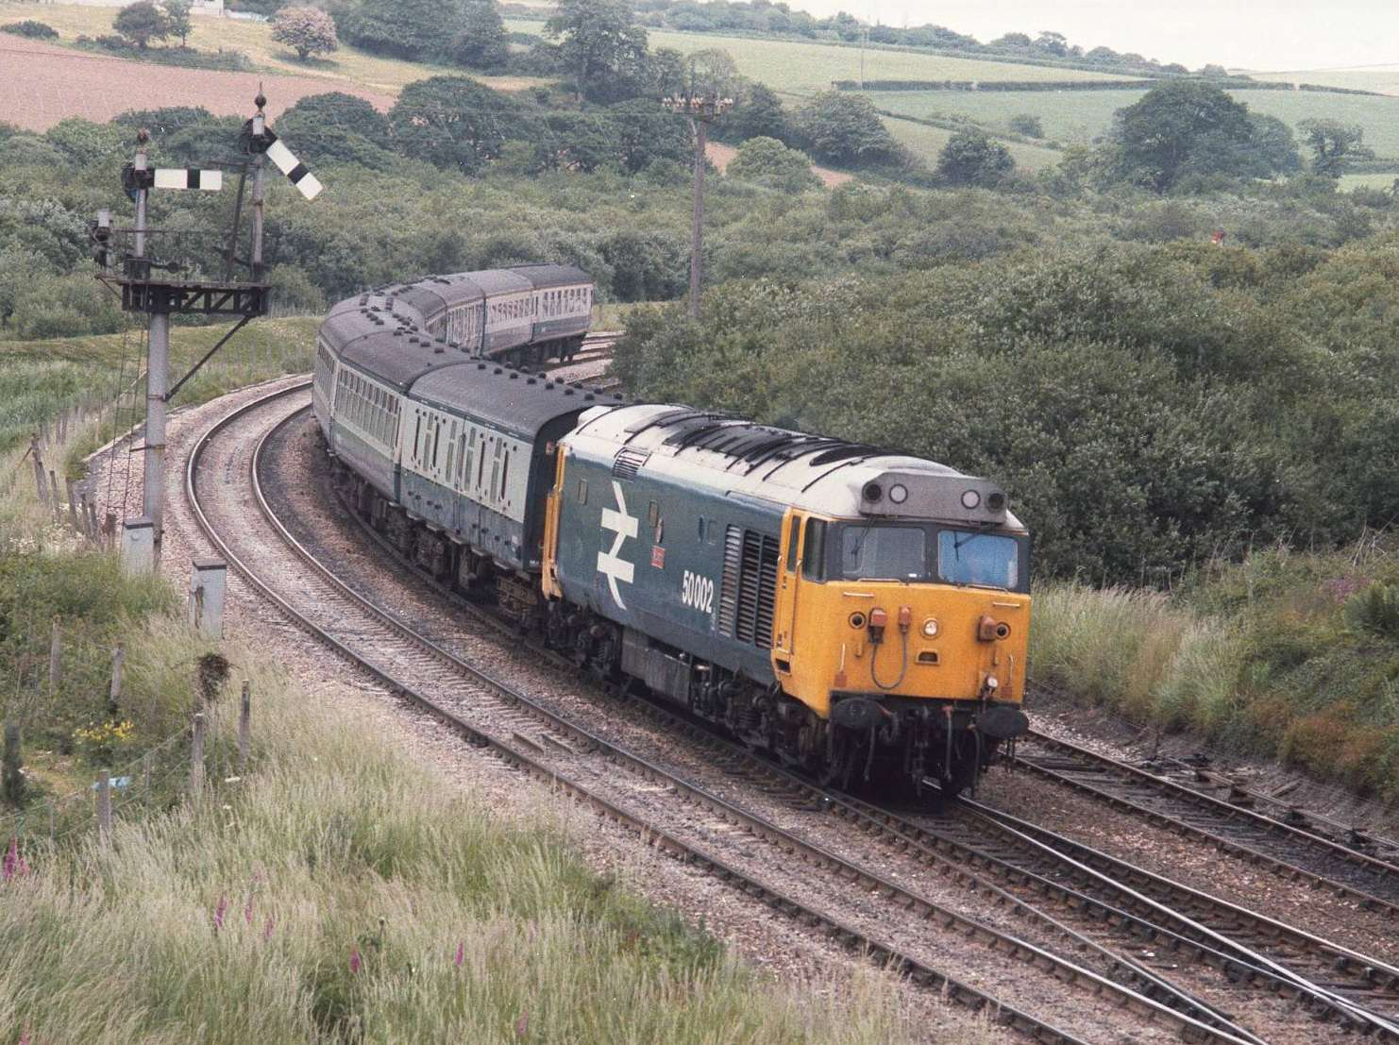
Chapters 1,2 & 3
“Hay” Textbook
CE 533

Slide 2
Chapter 1 – The Railroad Industry
Why are Railroads Built?
Early Concepts
  Europe/Asia—military
  —public
  U.S.—develop and profit but risk
  —private

Slide 3
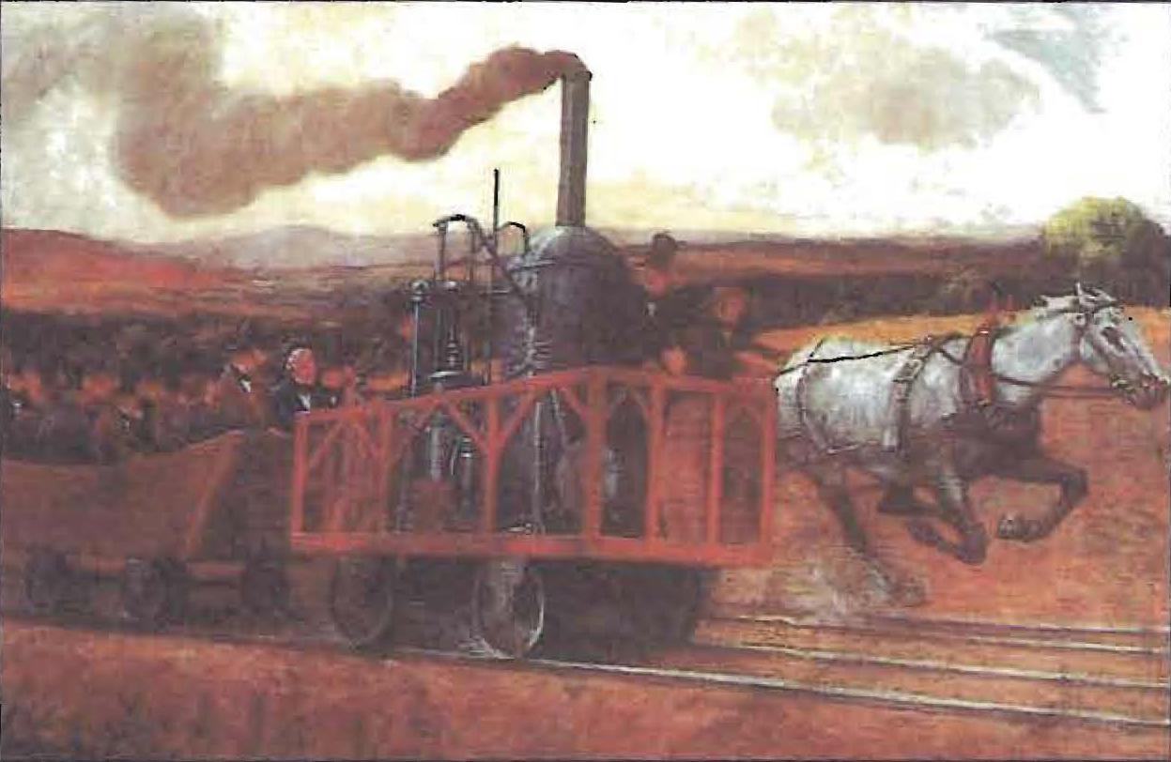
Today’s Concepts
U.S. to 1910 growth
1910 – 1950 stagnent
1950 – 2000 retrencement
2000 – ? growth

Slide 4
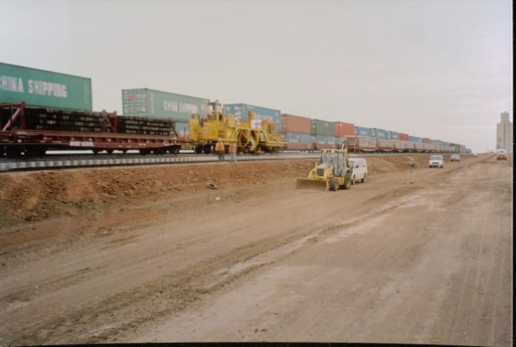
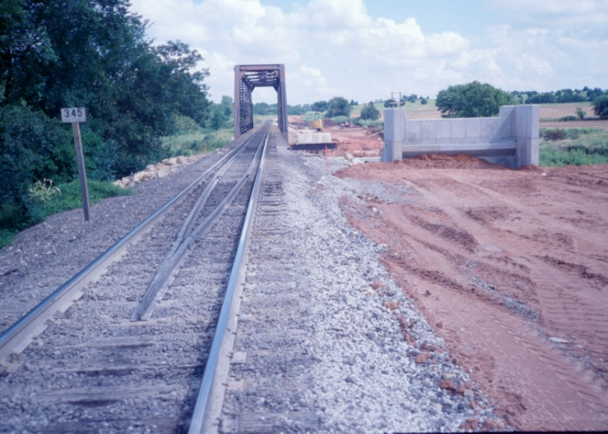
Today’s Concepts (Cond’t)
Capacity Improvements
Access New Sources (Power River)
Urban Passenger
High-Speed Passenger ??

Slide 5

Economical Needs
Essential Service Function
Essential Economy and Security
Public Support
Profit/Costs

Slide 6
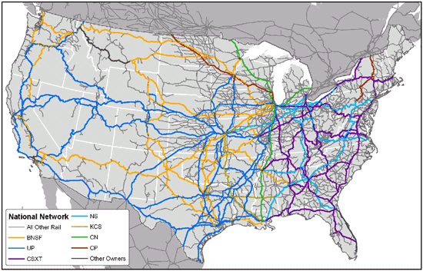
U.S. Railroad System
Class I
Regional
Short Line/Switching

Slide 7
Inherent Advantages:
bulk freight long distances
Passenger
Built-in depreciation
Common carriers

Slide 8
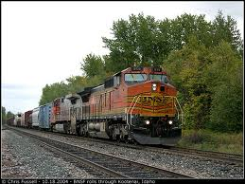
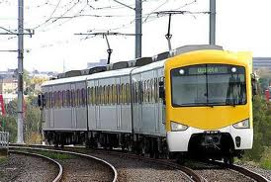
Chapter 2 – Nature of Railroad Traffic
Types of Traffic
Freight
Passenger

Slide 9
Traffic Forecasts
Traffic Survey
Single Feature
Topography
Character of Land and Communities
Traffic Census and Generation Models

Slide 10
Traffic and Marketing
  RR must sell Transportation – value added
  Shipper Concerns

Slide 11
  Traffic Department Must
    Obtain (Solicit Traffic)
    Negotiate and Set Rates

Slide 12

Chapter 3 – Revenues and Costs (Expenses)
Profit = OR – (CE + OE)
Operating Revenues
  Practically all from freight
E/R

Slide 13

Capital Expenses
Investment/Profit
Fixed Assets/Equipment
Write Off/Reduction of Value
Depreciation and Renewals

Slide 14
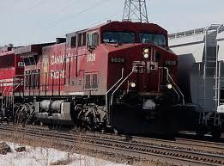
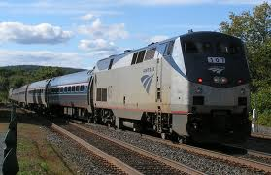
Operating Revenues
Practically all from Freight
Amtrak and Commuter Rail
Sell of Assets
Royalties

Slide 15
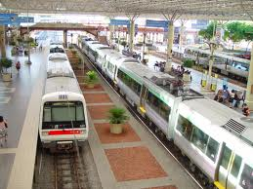
Operating Expenses
Continuing Costs
  Way & Structures
  Equipment
  Transportation
  General & Administration
Direct & Indirect

Slide 16
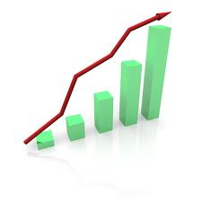
Unit Costs and Statistics
GTM
RTM
Costs per 1000 GTM
Costs per 1000 RTM
Train Mile
Costs per Train Mile
Costs per Track Mile Maintained

Slide 17
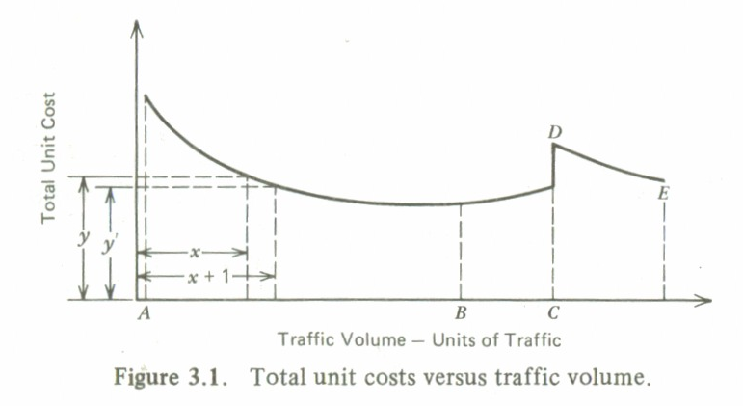
Operating Ratio
Unit Costs vs. Traffic Volume

