Slide 1
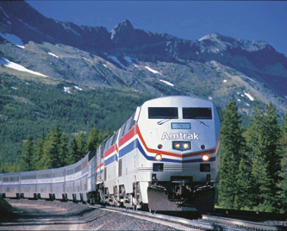
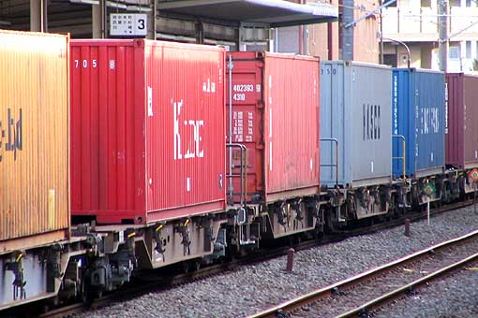
CE 533 Introduction to Rail Transportation (1)

Slide 2
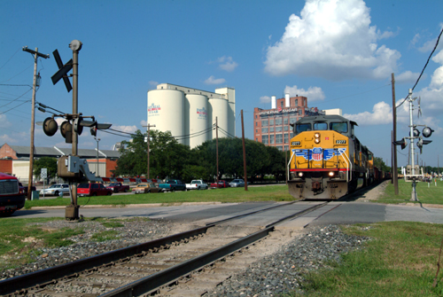
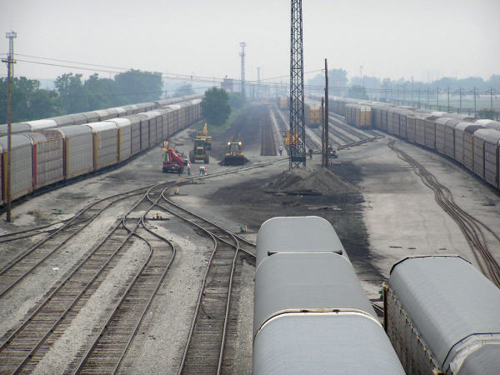
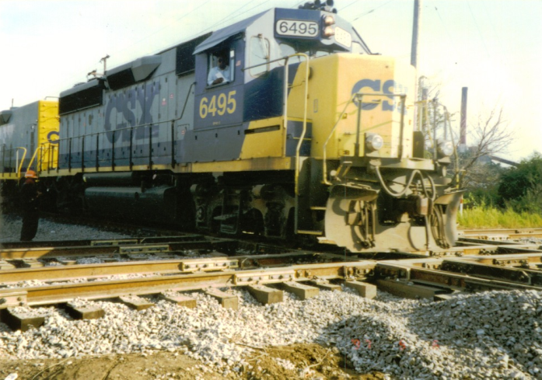
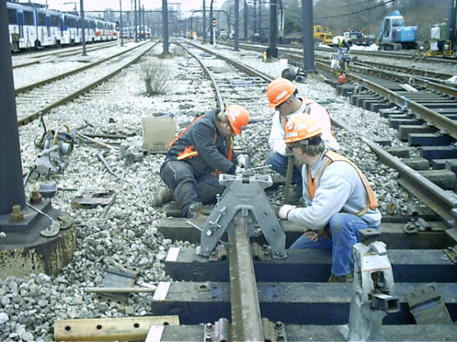
Railroad Industry – “Defined”
Right-of-Way & Track and Signals
Buildings, Bridges and Yards
Motive Power and Rolling Stock
People “Running” Trains

Slide 3
Railroad Industry –“Classifications”
National
Class I—7
Regional—20-30
Short Line—≈500
Kentucky—13
(3 Class I’s)
Lexington—2
(NS and RJC)
Annual Opt. Revenue
> $400 million
35-400
<35

Slide 5
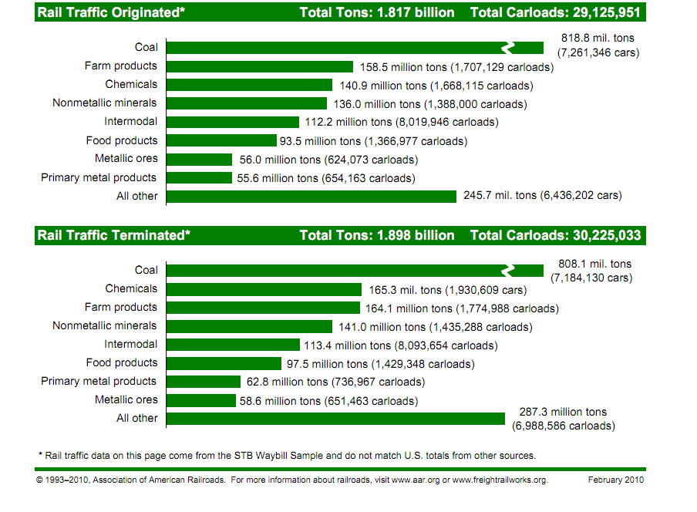

Slide 7
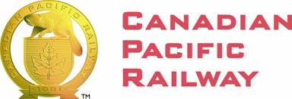
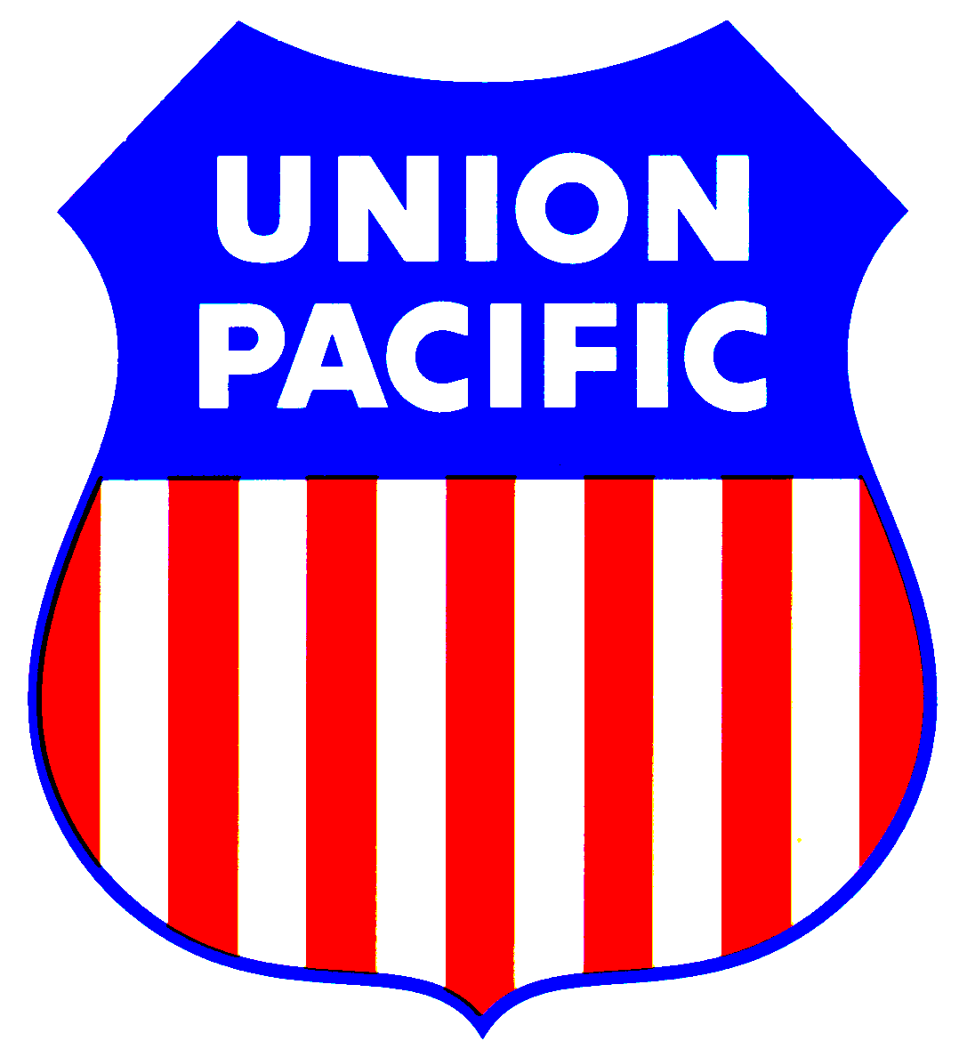
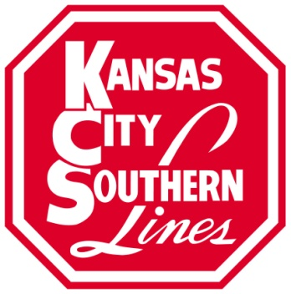
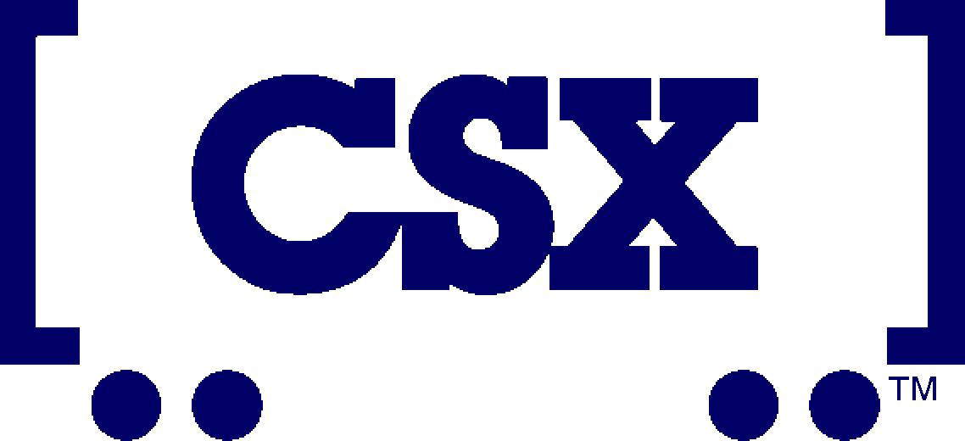
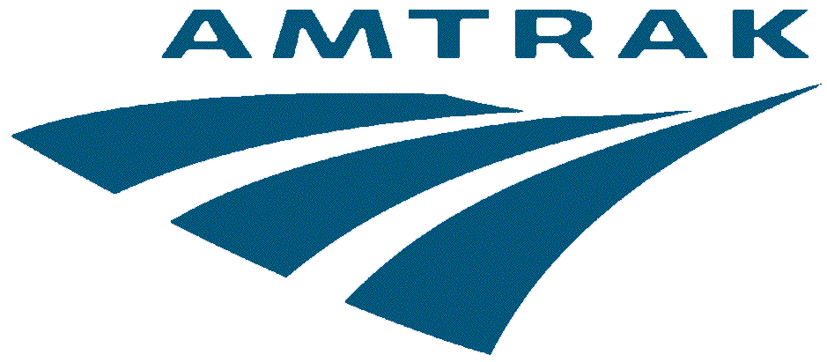
Major (Class 1) Railroads
…and over 500 short line & regional railroads

Slide 8
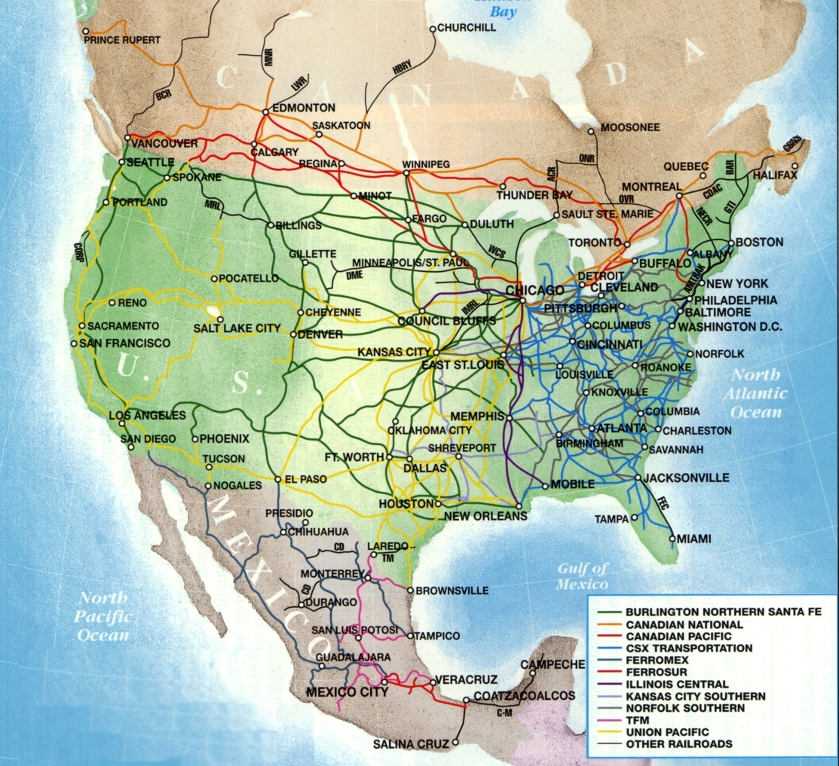
North American rail network
Major freight railroads
6 large North American freight railroads
CSX & NS in eastern US
BNSF & UP in west
CN & CP in Canada & central US
KCS is a medium sized railroad in central US
Amtrak operates passenger trains primarily on freight railroads’ trackage throughout US
(From Vantuono 2000)
Notes:
Point out wide coverage of continent.
These are almost entirely privately owned freight railroads, i.e. they largely own and maintain their own infrastructure and own and operate the trains. Very little government funding is involved, and in fact as privately held companies railroads pay taxes on assets and income.
Currently there are 6 large North American freight railroads. For a variety of historical reasons they tend to divide up geographically. In the US, two each in the east, west, and two Canadian roads in the north. East meets west in a small number of “gateway”s in the midwest with Chicago the largest and most important. Other important gateways are St. Louis, Kansas City, Memphis, and New Orleans.

Slide 9
Primary U.S. Railroads -- 2011
Big Four
East
CSX Transportation – merger of Chessie system (C&O, B&O, WM) and Seaboard System (ACL, SAL, L&N), also 42% of Conrail (NYC Portion)
Norfolk Southern Corp. – merger of Norfolk & Western (Wabash, Nickle Plate) and Southern System, also 58% of Conrail (Pensy portion)

Slide 10
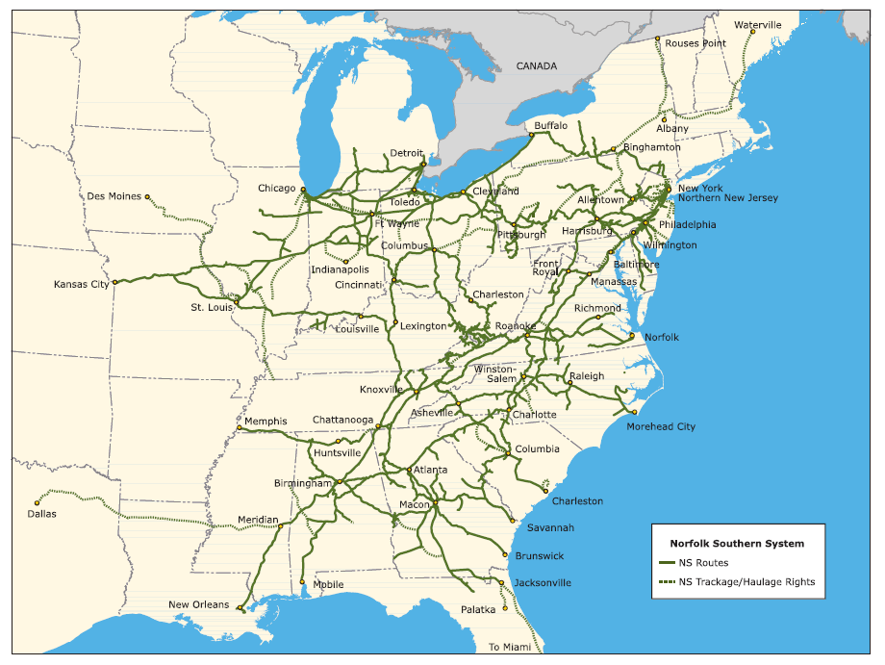

Slide 11
CSX Transportation
Montreal
Selkirk
Syracuse
Boston
One of seven Class I railroad companies in North America
Dates back to 1827
CSXT serves 23 states, the District of Columbia, and two Canadian provinces
Approximately 21,000 miles of rail network
Over 34,000 employees
Headquarters in Jacksonville, FL
Buffalo
Chicago
Detroit
Newark
New York City
Toledo
Willard
Harrisburg
Pittsburgh
Philadelphia
Columbus
Cumberland
Baltimore
Indianapolis
Cincinnati
Charleston
Washington D.C.
East St. Louis
Huntington
Norfolk
Louisville
Rocky Mount
Nashville
Knoxville
Charlotte
Hamlet
Memphis
Atlanta
Charleston
Birmingham
Montgomery
Savannah
Waycross
Jacksonville
Pensacola
New Orleans
Tampa
Orlando
West Palm Beach
Miami

Slide 12
Primary U.S. Railroads -- 2011
Big Four
West
Union Pacific – merger of Southern Pacific and several other railroads; MP, C&NW, DRGW, WP, MKT
BNSF – merger of Burlington Northern (GN, NP, Burlington, Frisco) and the Santa Fe

Slide 13
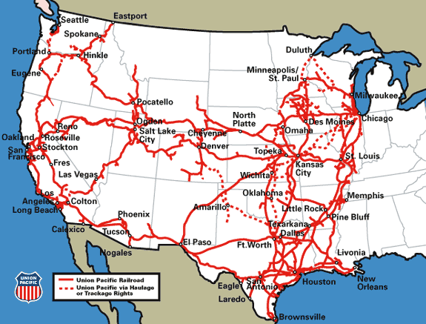

Slide 14
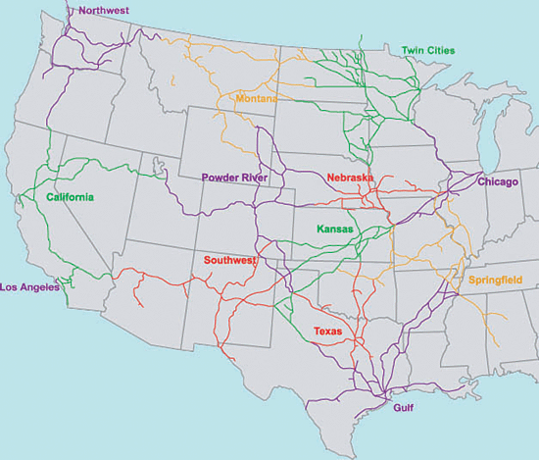
BNSF

Slide 15
Primary U.S. Railroads -- 2011
Others (smaller)
Canadian National (with Illinois Central and GTW)
Canadian Pacific (with Soo Line, Milw, and W.C.)
Kansas City Southern (with Mexican railroads)
Florida East Coast (Part of Rail America)
Pam Am Railways New England Area

Slide 16
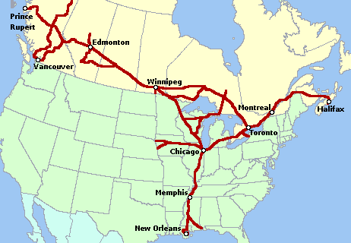
Canadian National

Slide 17
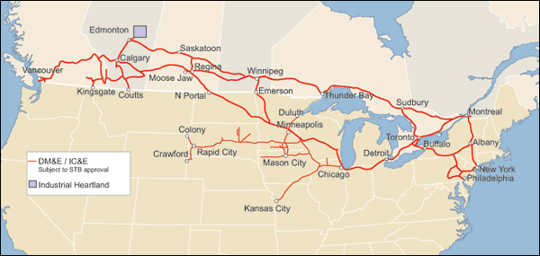
Canadian Pacific

Slide 18
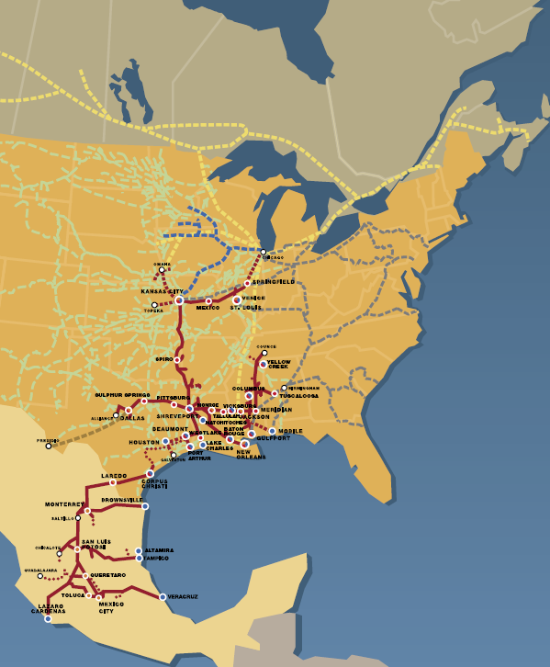
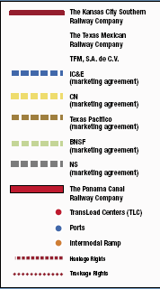
Kansas City Southern

Slide 19
Primary U.S. Railroads -- 2011
Regionals
Several (≈ 30)
Short Lines
Many (≈ 500)
Holding Companies:
Genesee & Wyoming
Rail America
Individual Companies

Slide 20
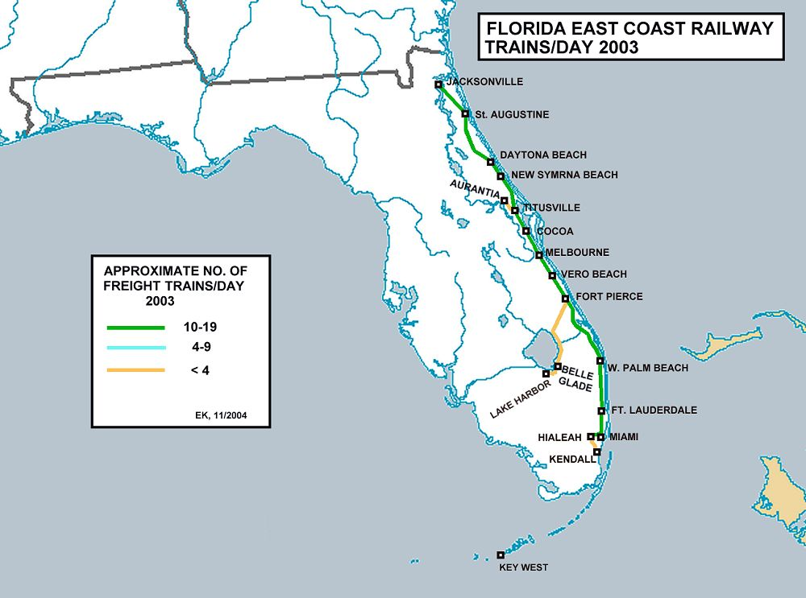
Florida East Coast

Slide 21
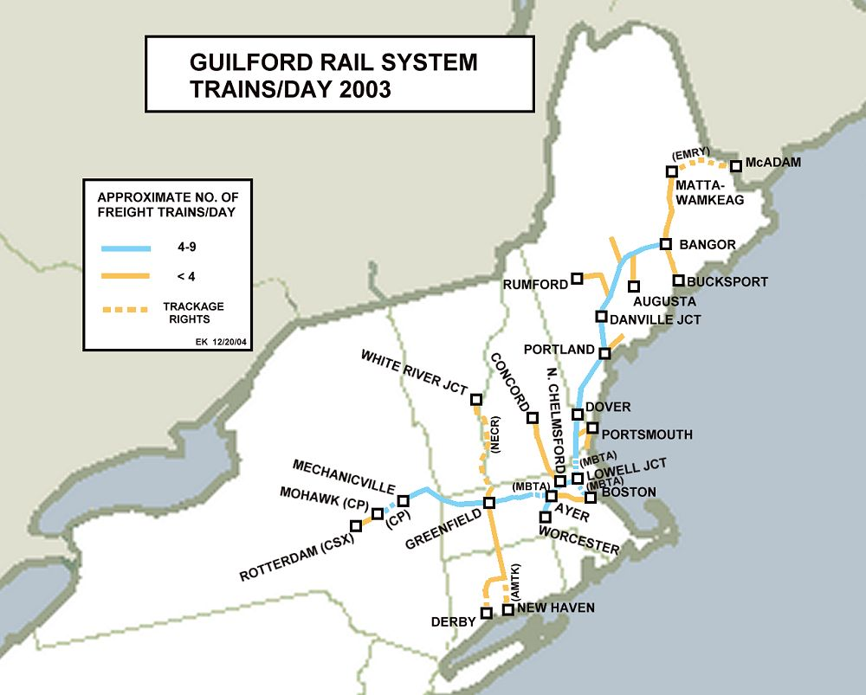
New England Rail System
Guilford Industries

Slide 26
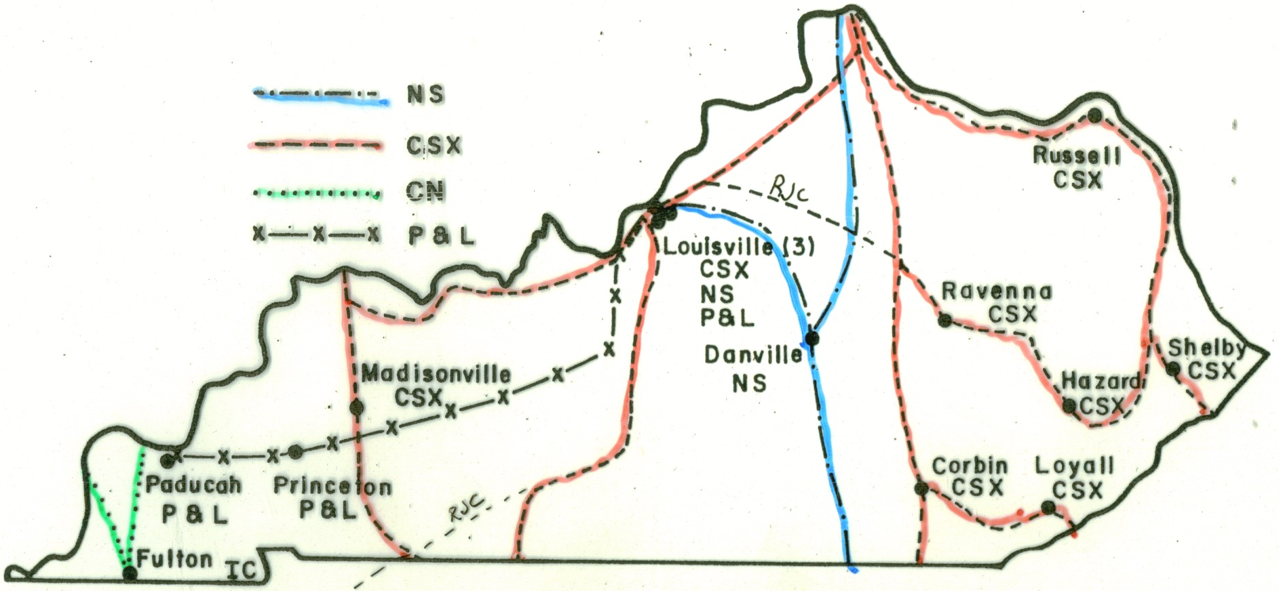

Slide 27
